Slide 1

PURA AND THE VARIOUS SALARY INCREASES
EXPLANATION
Presented by: TEAM APER

Slide 2

AGENDA
Introduction
PURA AND MANAGERS
THE DIFFERENT SALARY INCREASES
QUESTIONS

Slide 3

INTRODUCTION

Slide 4

INTRODUCTION
As we have received a lot of emails and questions related to the PURA system and the various salary increases over the past few months, we wanted to prepare a training session on the 2 topics so that you are better able to master these 2 concepts.

Slide 5
THE PURA SYSTEM AND FRAMES

Slide 6

THE PURA SYSTEM
Processus unique de reconnaissance d’ancienneté (PURA)
The Single Seniority Recognition Process (PURA) is an agreement negotiated with certain labour organizations that aims to recognize, among other things, the seniority of the following people:
Employees of the health and social services network (RSSS) who have worked in more than one institution during their career;
Personnel from placement agencies or independent labour who have been hired in an RSSS institution OR who wish to join the public network.

Slide 7
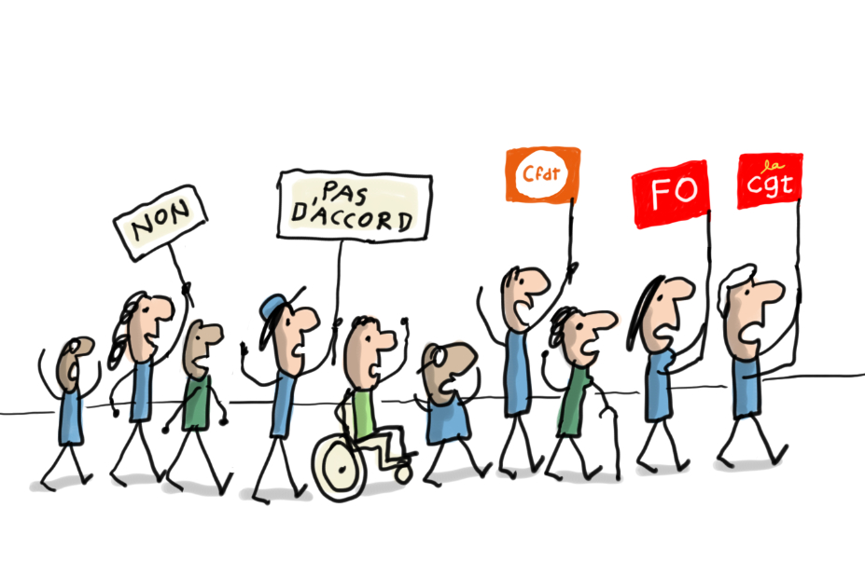
THE PURA SYSTEM
The trade union organisations concerned are:
• the Fédération de la santé et des services sociaux (FSSS-CSN);
• The Canadian Union of Public Employees (CUPE-FTQ)
• the Syndicat québécois des employées et employés de service, section locale 298 (SQEES-298-FTQ); • the Syndicat de professionnelles et professionnels du Québec (SPGQ);
• the Fédération de la santé du Québec (FSQ-CSQ);
• Fédération interprofessionnelle de la santé du Québec (FIQ);
• the Teamsters Union Quebec, Local 106 (FTQ).

Slide 8
THE PURA SYSTEM
The objective of the PURA is to allow an eligible employee to be recognized for his or her seniority previously acquired in a category 1 to 4 or SNS in the Health and Social Services Network (RSSS).
The two main eligibility criteria for PURA are:
Be employed by Santé Québec as of May 31, 2025.
Belong to one or other of the union or SNS categories.
Category1: Nurses
Category 2: Support staff
Category 3: Administrative staff
Category 4: Professional and technical personnel/SNS: Non-unionized unionizables
To facilitate the identification and aggregation of data from the current GIP and Medisolution payroll systems of all HSSN employers as well as data from Retraite Québec. The platform also allows active employees of Santé Québec as of May 31, 2025, to consult the episodes of employment taken into account in the PURA calculation and the associated recognized seniority. Only people with an active professional email address have access to the PURA platform.

Slide 9

THE PURA SYSTEM AND MANAGERS
First, it should be noted that the principle of seniority accrual applies to an employee who is part of a certification unit of a union.
Managers do not have seniority because they are not unionized, but they do have years of service that include years of service (seniority) as a unionized employee.

Slide 10
THE DIFFERENT SALARY INCREASES

Slide 11
INTRODUCTION
As we have received many emails and questions related to the different salary increases that a manager can receive during his or her career, we have prepared this training so that you are better able to control and understand your salary.

Slide 12

SALARY WHEN YOU BECOME A MANAGER OR FOLLOWING A PROMOTION

Slide 13
APPOINTMENT TO AN EXECUTIVE POSITION
15. A person who accesses a middle management position, from a unionized employee or a non-unionized unionizable employee position or from outside the health and social services sector, receives as his salary the greater of the following 2 amounts:
— the minimum of the salary class of the post to which he or she is accessed;
— 110% of the salary she received before her appointment

Slide 14
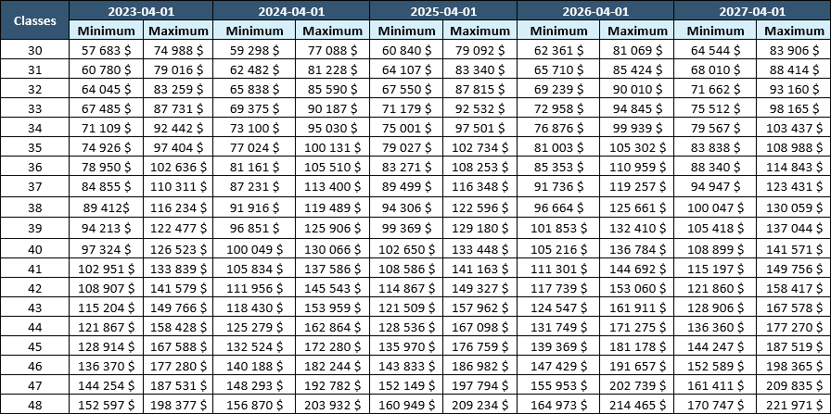
THE NEW WAGE CLASSES

Slide 15
PROMOTION
18. The salary of a promoted middle manager is the greater of:
— the minimum salary class of the post to which he or she is accessed;
— 110% of the salary he received before his promotion, but this amount, subject to Article 24, does not exceed the maximum salary class of the post to which he is appointed

Slide 16
THE NEW WAGE CLASSES

Slide 17
YOU ARE NOT AT THE MAXIMUM OF YOUR SALARY CLASS
14. On April 1 of each year, a salary progression will be granted to the executive unless the manager's performance in the year ending March 31 is deemed unsatisfactory. The employer's assessment to this effect is sent to the manager in writing during the reference period. This assessment cannot be appealed.

Slide 18
YOU ARE NOT AT THE MAXIMUM OF YOUR SALARY CLASS
The modalities of progression are established as follows:
1° 0% where the manager does not meet the expectations indicated;
2° 2% when the manager partially meets the expectations indicated;
3° 4% when the manager meets the expectations indicated;
4° 6% when the manager far exceeds expectations
(the employer grants 6% to a maximum of 25% of the managers who are progressing).
When an employer does not evaluate the manager's performance, a salary increase of 4% is granted to the manager

Slide 19
THE NEW WAGE CLASSES

Slide 20
SECTIONS 24 AND 25
ANOTHER FORM OF SALARY INCREASE FOR CERTAIN MANAGERS

Slide 21
ARTICLE 24
Considering the salary inequity caused by union negotiations on the salaries of certain professionals, the manager therefore receiving less than the professionals he supervises, the regulation provides for special terms and conditions so that these managers obtain, under certain conditions, 110% of the salary of the supervised profession.

Slide 22
DETAILED RULES FOR THE APPLICATION OF ARTICLE 24
24. Despite the determination of a maximum for each salary class, the maximum salary that a manager may reach is set at 110% of the maximum rate of the salary scale in force, including the additional remuneration related to post-school training, if any, in the health and social services sector for his profession when this new possible maximum is greater than the maximum of the salary class established for his position, provided that this profession is generally required for the position held. In such a case, the manager's salary is not considered to be out of class.

Slide 23
DETAILED RULES FOR THE APPLICATION OF ARTICLE 24
For the purposes of the first subparagraph, the following conditions shall be fulfilled simultaneously:
(1) the manager has reached the maximum of his or her salary class on 1 April;
(2) the occupation and the benchmark job, identified and determined by the employer, are required for the position held; where an occupation contains only one title of the unionized or unionized non-unionized job, this title becomes the benchmark job used by the employer;
(3) the maximum of the salary scale for the occupation and the benchmark job, increased by 10%, exceeds the maximum of the salary class of the position held by the manager;
4° the manager holds the level of academic training required by the title of the unionized benchmark job or non-unionized union member corresponding to the required profession.

Slide 24
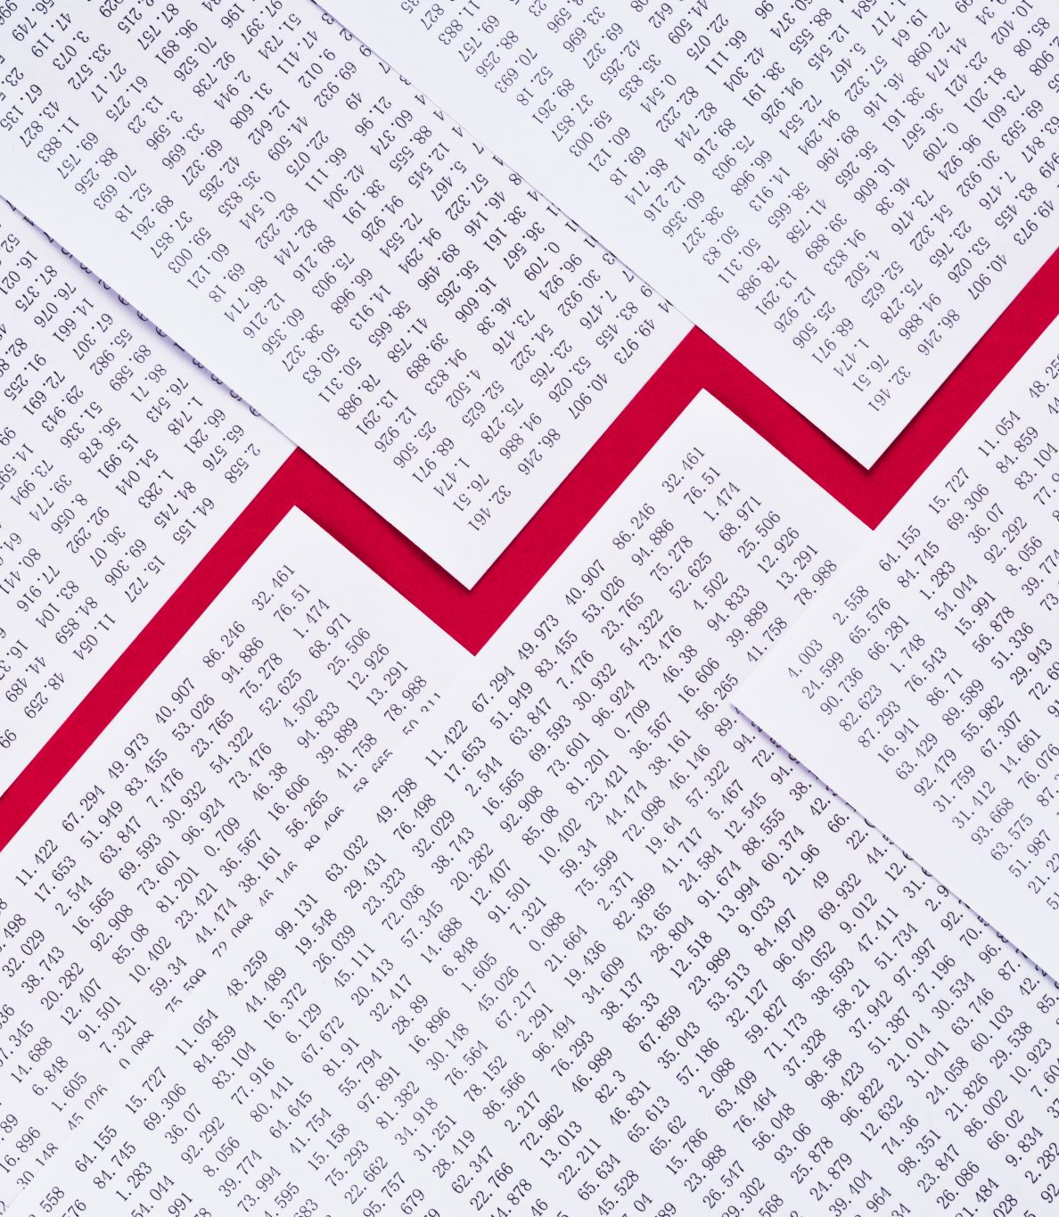
EXAMPLE OF ARTICLE 24
HEAD NURSE – CLASS 37 SUPERVISES A BACC Assistant Head Nurse
110% OF THE BACHELOR'S SALARY AT A RATE OF 37.5H / WEEK: $59.12 X 37.5 X 52.18: $115,683
MANAGER’S SALARY: Max: $116,348
110% OF THE EMPLOYEE'S SALARY: $115,683 X 110%: $127,251
TOTAL: The MANAGER will not make $116,348 but $127,251

Slide 25
ARTICLE 25
25. Where the application of the rule provided for in section 24 no longer makes it possible to maintain a 7% difference between the salaries of managers at different levels in the same hierarchical line, and the higher-level manager has reached the maximum of his or her salary class, the employer shall add an amount to the salary of that manager in order to maintain a 7% difference. In such a case, the manager's salary is not considered to be out of class.

Slide 26

LES AUGMENTATIONS SALARIALES
April 1, 2023: 6%
April 1, 2024: 2.8%
April 1, 2025: 2.6%
April 1, 2026: 2.5%
April 1, 2027: 3.5%
For a total due on 1 April 2025 of 11.4%
It is in fact increasing by the same % the bottom and ceiling of a salary class

Slide 27
THE NEW WAGE CLASSES

Slide 28


APER
Telephone:(514) 933-4118
association@aper.qc.ca
www.aper.qc.ca
THANK YOU

