Slide 1
APER's major recruitment competition
Recruit and win a trip!

Slide 2
APER is growing but we need you
We have increased our membership by 47% in the last 2 years.
We have developed 9 additional partnerships to what we already had.
We are now the association with the largest number of subscribers on LinkedIn.
We want to support as many managers as possible throughout their careers.
Since Santé Québec and the TBS are no longer investing in the development of managers, we have plenty of ideas for developing more!
We are already the manager’s association with the largest range of services and we are working to give you even more!

Slide 3
A bit of history…
Since 1996, the government has given a considerable advantage to AGESSS by indicating in the regulation on the working conditions of managers, the following article:
3.12. The employer deducts from the salary of each of the middle managers in his employ the amount of the professional contribution set by an association of middle managers, in accordance with this subsection, on condition that this association demonstrates to him that the middle managers in his employ are members, on April 1 of the current year, of such association of middle managers in a proportion of at least 50%.
To continue to deduct this professional contribution, the employer ensures that on February 1 of each year, the proportion of middle managers in his employ who are members of this association is equal to or greater than 50%.
However, a manager may pay his contribution otherwise if he notifies the manager’s association in writing with a copy to the employer.

Slide 4
A bit of history…
In 2015, Article 3.12 was declared illegal but has not been amended to date (work in progress).
Since this judgment, the MSSS has issued a directive to establishments that they must provide pamphlets from the two associations and allow the manager to join the association of their choice, but this is not always respected given the regulations which have still not been amended.
Since the creation of Santé Québec, we have observed better collaboration to allow managers to join the association of their choice.
As APER is a non-profit organization, all funds are reinvested to offer you more services.

Slide 5
You are the best ambassadors of APER!
Always with the aim of developing our range of services (offering more training, more coaching support, more partnerships, etc.)
APER wishes to continue its growth in order to allow as many managers as possible to benefit from our services.
Since our members have chosen us, you are the best people to convince your colleagues to join us!
The APER absorbs the penalty fees required by the AGESSS from all managers who join the APER and who leave the AGESSS.
Therefore, today we are launching our new recruitment campaign with a contest allowing you to win a $1,500 Air Canada travel credit.

Slide 6
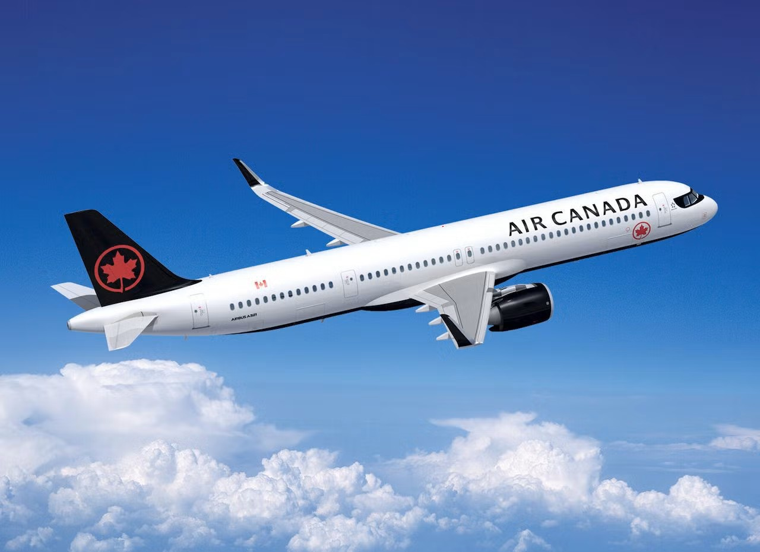
Recruit a member and get a chance to win a $1,500 gift certificate with Air Canada
This gift certificate can be exchanged for airline tickets or with Air Canada Vacations.

Slide 7
Rules
The competition is valid from October 24, 2025 at 8:00 a.m. and ends on February 6, 2026 at midnight.
The draw will take place on February 13, 2026 at 10:00 a.m. under the supervision of the members of the APER Board of Directors.
For each member recruited, you get one entry into the draw, so the more you recruit, the more chances you have to win!
The newly recruited member must be sure to check that they heard about us from a colleague and specify your name as the referring member. In addition, they must return the completed forms to the following address: association@aper.qc.ca as well as to the management service of their establishment before February 6, 2026 at midnight. (Help them complete everything!)
The member who recruits a colleague must send us the name and email address of the recruited member to the following email address: association@aper.qc.ca, indicating in the subject line: Competition.
The referring member and the referred member can come from 2 different establishments or from the same one.
Once we have received the completed forms from the new member, the referrer's participation is confirmed.
Everything is conditional on the acceptance of the new member by the APER Board of Directors (the new member must not be in a dispute at the time of joining).

Slide 8

Membership and authorization of deduction at sources Forms
To make things easier for you, we will send the forms to be completed to all our members tomorrow so that you can simply forward them to your colleagues who wish to join APER.

Slide 9

Good luck to all!

