Slide 1


Group Banking offer
An exclusive offer of advice and banking solutions
– value of up to $2,900† per employee

Slide 2
Agenda
1. Why partner with CIBC?
2. The benefits of the Group Banking Offer
  Benefits for your Organization
3. The Group Banking Offer
4. Next steps

Slide 3

Benefits of the Group Banking Offer
Financial health
affects the bottom line.
This is an opportunity for your organization to:
  Enhance your benefits package by offering exclusive financial offers, not available to the public
  A strong benefits package helps to attract and retain members
  Increased financial wellness contributes to enhanced member satisfaction
The offer provides your employees with:
  The convenience of having all their banking products under one roof
  Improved financial wellness through our preferred banking program
    Removes burden of many account fees
    Preferred rates
  Personalized advice and planning from a team of advisors to support short- and long-term goals
Members who are stressed about their
finances are less productive than their peers.
76%
2x
  76% of financially stressed members say financial worries have had a negative impact on their productivity.¹
  Members satisfied with their benefits are 2x more likely to be satisfied with their jobs.²
7x
1.6x
  Financially stressed members are 7x more likely to say their attendance at work is impacted.¹
  Members who are satisfied with their association’ wellness program & benefits are 1.6x more likely to stay.²
¹ 20th Annual MetLife Study of member Benefit Trends, 2023.
² PwC member Financial Wellness Survey, 2023.
Notes:
This program is really about enhancing your benefits offering in a way that directly supports your employees’ financial well-beings
From an organizational perspective, it is an easy way to strengthen your total rewards package. Ultimately, this offer is not only about financial perks, but also improving employee well-being in a way that supports both talent and business outcomes. We can also hold webinars for topics that are of interest to your employees- investing etc. and truly support them on their financial journey
On the employees side, in this economy it really removes the burden of account fees and provides convenience, savings, and personalised advice to support their goals. o this is an exclusive offer not available to the general public with an overall value of 2900 to each of you
These offers are better than pur mass offer and theres something for everyone. It’s a complete offer with many account fees waived off and preferred rates on lending

Slide 4



For L’APER
• Substantial savings on essential banking
• Access to quality financial products and advice
• Personalized support for financial management and growth.

Slide 5
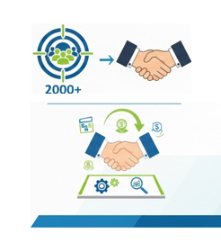
Benefits for CIBC
• Access to a targeted and engaged client base of 2,000 professionals
• Opportunity to build lasting relationships with members by offering them personalized solutions

Slide 6

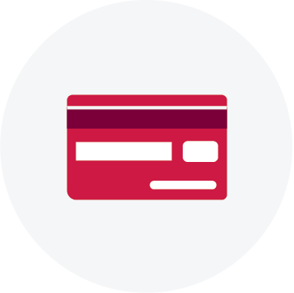
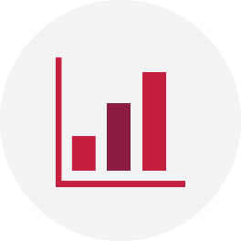
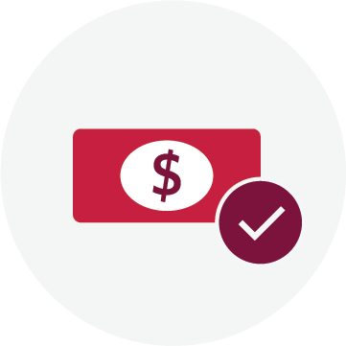


CIBC Group Banking Offer
A value of up to $2,900†
  We want to build a strong relationship with your organization by supporting your employees with their financial needs, well-being and success through exclusive banking offers and personalized advice. This offer will go live in Jan 31st, 2026.
CIBC Smart™ Account
$200 value
Pay no monthly fee for 1-year¹.
+ Bundle Bonus
Get up to $600 cash²
When you open both a Smart Account and eligible credit card and complete the qualifying actions.
Total value of up to $800
.
CIBC Credit Cards
A value of up to $1500³
Receive up to a 2-year annual fee rebate for you and 3 authorized users on new eligible CIBC credit cards.⁴
+ Exclusive Welcome Bonus
Self-Directed Investing
A value of up to $695⁵
Get 100 commission-free online stock and ETF trades over two years.
Loans and Lines of Credit
0.5% Savings via CIBC Preferred Rates⁶
0.5% off the best approved rate for unsecured lending
CIBC Home Power Plan® Line of Credit at a lower interest rate of CIBC Prime + 0.5%
Advice & Planning
Access to CIBC financial advice
Dedicated financial advisors and planning experts, plus exclusive rates on savings and investments.
CIBC financial tools including:
CIBC Smart Planner
CIBC Goal Planner™
*The Terms and Conditions here can be found via: https://www.cibc.com/en/group-banking/members.html
**Offer are subject to change from time to time
Notes:
Here is a snapshot of what’s include – this is our newest offer which will go live on Jan 31st
Our offer provides up to $2,900 in value, through several components:
A CIBC smart account with no monthly fee for 1 years plus a $500 cash upon opening your first CIBC Smart Account and completing the qualifying actions
On top of that, a $100 bundle bonus if you open both a smart account + eligible card
For credit card, annual fee rebates for 2 years + welcome points depending on the credit card
On the investment side, 100 commission-free trades for investing
On top of that, they’ll get preferred banking rates and have access to personalized advice from our team of financial advisors
All in all, It removes the burden of a lot of typical account fees, which can really add up. Also, it makes it easy for employees to manage all their banking under one roof, which makes life easier. It is designed to be convenient and flexible.

Slide 7





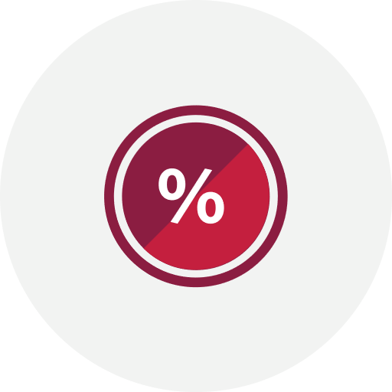
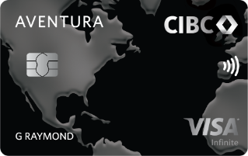
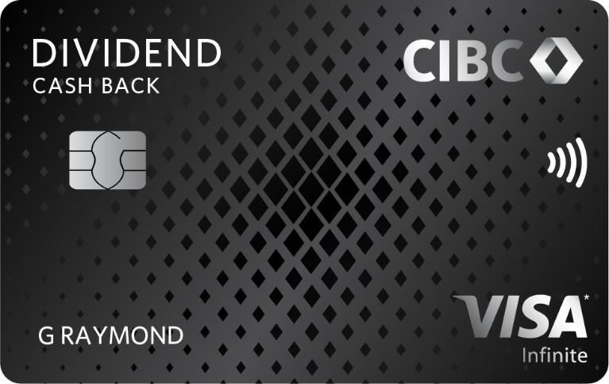
Let’s dive into some details
Smart Account
Credit Card
Investing
Pay no monthly fee for 1 year
Up to 2-year annual fee rebate on new eligible credit cards
Get the rewards and benefits you want with the right credit card - Plus, earn exclusive welcome bonus of points or cash back
CIBC Investor’s Edge
Commission-free trading
100 free online Canadian and U.S. stock and ETF trades, which you can use within 2 years.
Save on the regular rate of $6.95 ($695 value).
No minimum balance
Get started without worrying about maintaining a minimum balance.
Unlimited transactions, including Interac e-Transfer® service
How to get $500 cash:
Open your first CIBC Smart™ Account, then within 2 months:
1
Set up recurring direct deposits of $500 or more per month from your employer, government or pension
Travel
Cash Back
Low Interest
2
And complete 1 of the following actions within the same calendar month:
2 recurring pre-authorized debits
2 online bill payments of $50 or more each
5 online Visa Debit purchases
Trade smarter, not harder, with CIBC Investor’s Edge
This offer applies to the following eligible cards:
CIBC Aventura Visa Infinite Card
CIBC Dividend Visa Infinite Card
CIBC Dividend Platinum Visa Card
CIBC Aventura Gold Visa Card
CIBC Aeroplan Visa Infinite Card
Open a CIBC Investor’s Edge Account here
Choose from TFSA, RRSP, RRIF and non-registered accounts.
Use promo code EDGEGB
How to get $100 bundle bonus:
Open a CIBC Smart Account, set up recurring deposits of $500+ within 60 days, and get approved for an eligible credit card within 30 days
Learn more
Learn more
Learn more
Offer can be availed online using the link shared in the flyer + In person at the banking centre
(please bring one of the following – Business card, job card, pay stub, benefits card)
Apply online using code “EDGEGB”
Notes:
A pre-authorized debit is when you give a merchant or service provider your transit and account number to set up a recurring bill, loan or mortgage payment. If you give them your CIBC Advantage Debit Card® information, this is a Visa* Debit transaction, not a pre-authorized debit.
Examples of pre-authorized debits
hydro bills
CIBC mortgage payments
https://www.cibc.com/en/special-offers/smart-cash-offer.html?utrc=S232:299&&gclsrc=aw.ds&gad_source=1&gad_campaignid=990035513&gbraid=0AAAAADttJEdkUGuTeB4NkQMHLsUZu1qSO&gclid=EAIaIQobChMI8bn1192GkgMVMW1HAR0TjQ89EAAYASAAEgJAh_D_BwE
Here is a closer look at the key components. ​
For banking, no monthly fee for one years and unlimited transactions. ​
For credit card, employees can choose the card that fits their lifestyle – whether that’s travel rewards, cash back, or low interests - and received a 1~2-year annual fee rebate depending on the credit cards.
For investing, they get commission free trading with no minimum balance, giving them a simple way to start or expand their investments.

Slide 8


Group Banking Services Program
Mortgage Component: Let’s build your dreams together.
-Personalized Consultation with Experienced Mortgage Advisors (MA’s) Dedicated to APER Members
-Private advisory sessions or educational workshops on home buying, refinancing, or rental property investment
.Free Mortgage Portfolio Analysis
-Complimentary review of members’ existing mortgages to identify savings or optimization opportunities.
-Advanced digital tools to facilitate application submission and tracking.
-Exclusive Events
-Organization of webinars, seminars, or open house days reserved for APER’s members.
-Tailored Solutions: Professional Program, Newcomer Program, High-Value Client Program, Rental Property Program.

Slide 9



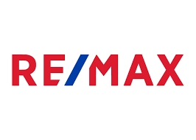






















Partnership Dashboard
~450 Enrolled Partners
Logos below represent a sampling of these partners.
All Employees/Locations
Enrolled Locations Only
5
Notes:
We’ve made strong progress in growing our Group Banking partnerships, with over 400 enrolled partners. This slide highlights some of the businesses we work with, categorized into two segments.
• All Employees/Locations: Companies like RE/MAX, TELUS, Suncor, and 3M have extended these offers to their entire workforce.
• Enrolled Locations Only: Businesses like Canadian Tire, McDonald’s, and Shoppers Drug Mart have specific locations participating in the program.

Slide 10


Philippe Michel
Conseiller Prêt Hypothécaire | Mobile Mortgage Advisor |
Cell: 514-771-9061
philippe.michel@cibc.com

Slide 11


Christopher Durafils
Conseiller Prêt Hypothécaire |
Mobile Mortgage Advisor |
Cell: 514.967-5747
Christopher.durafils@cibc.com

Slide 12
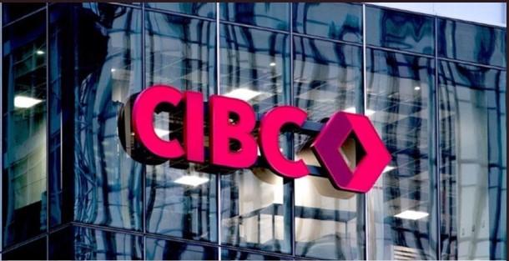
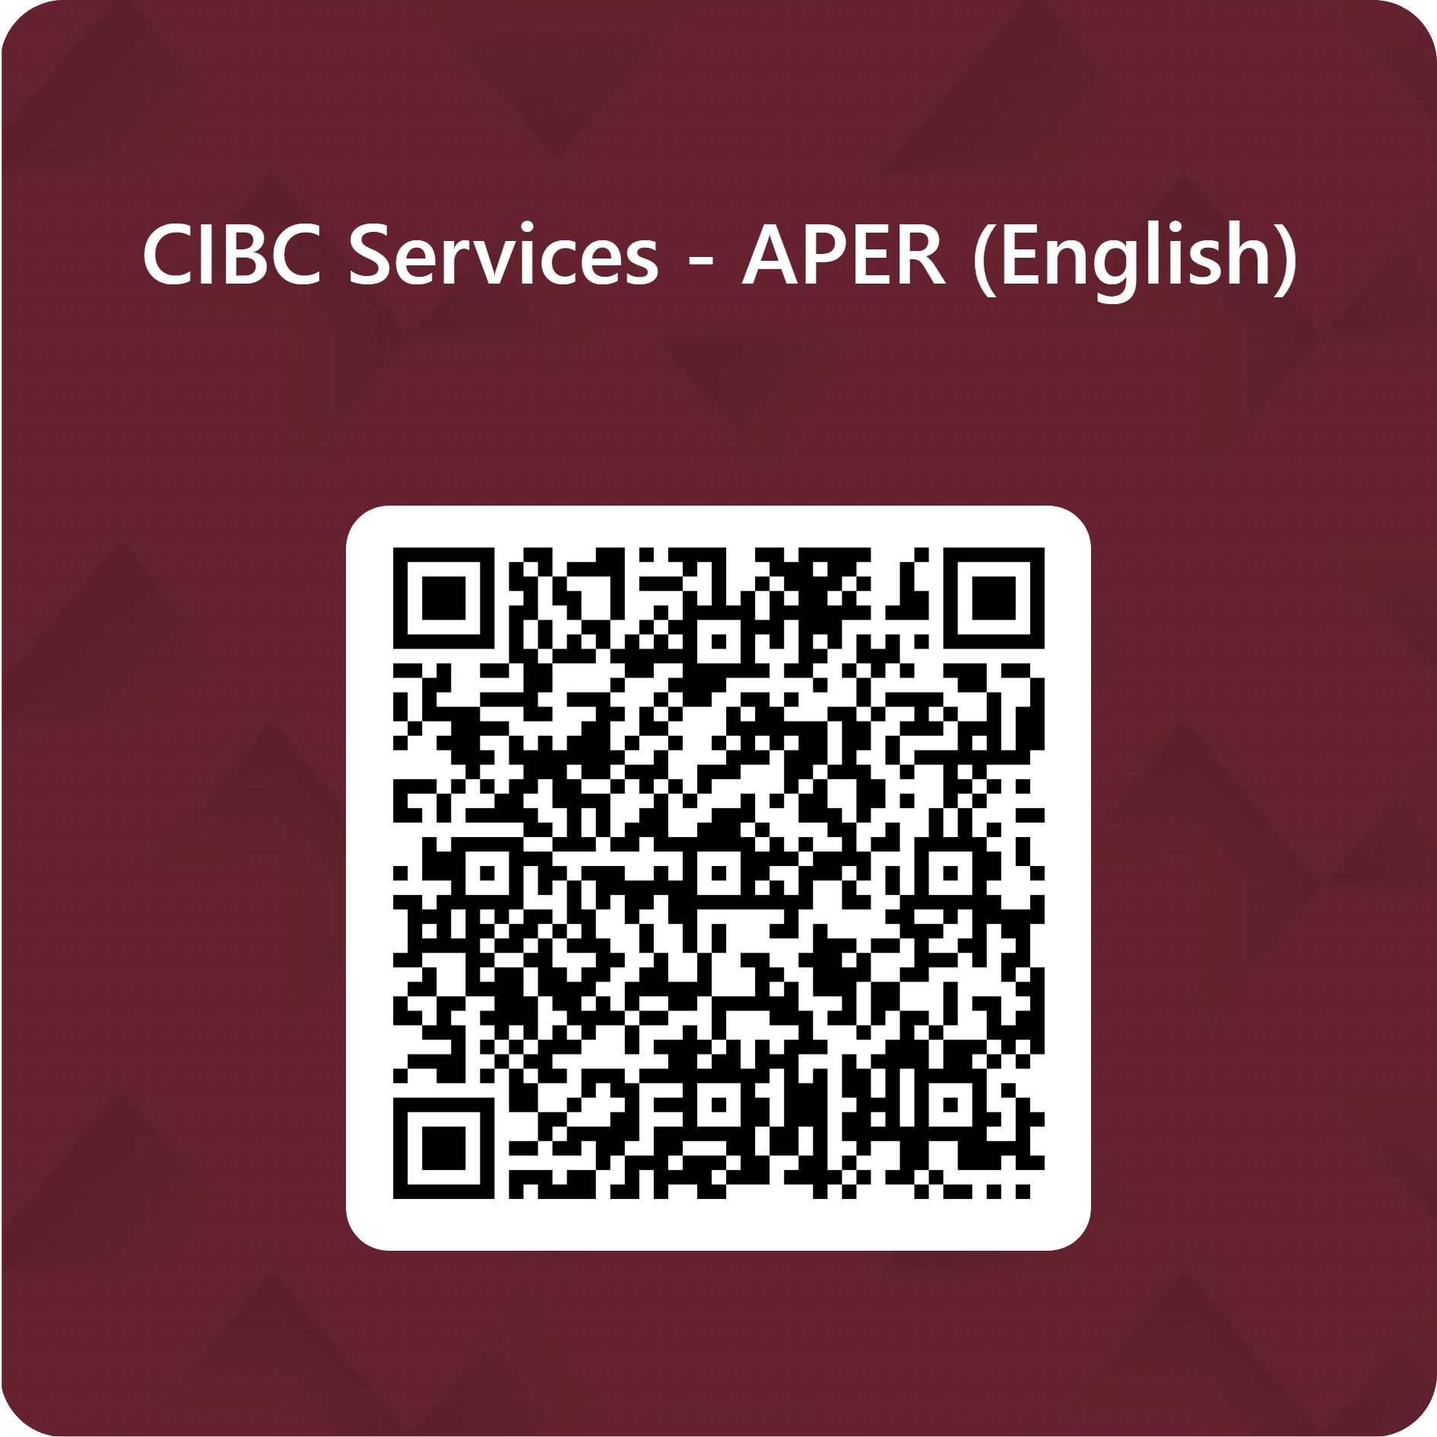
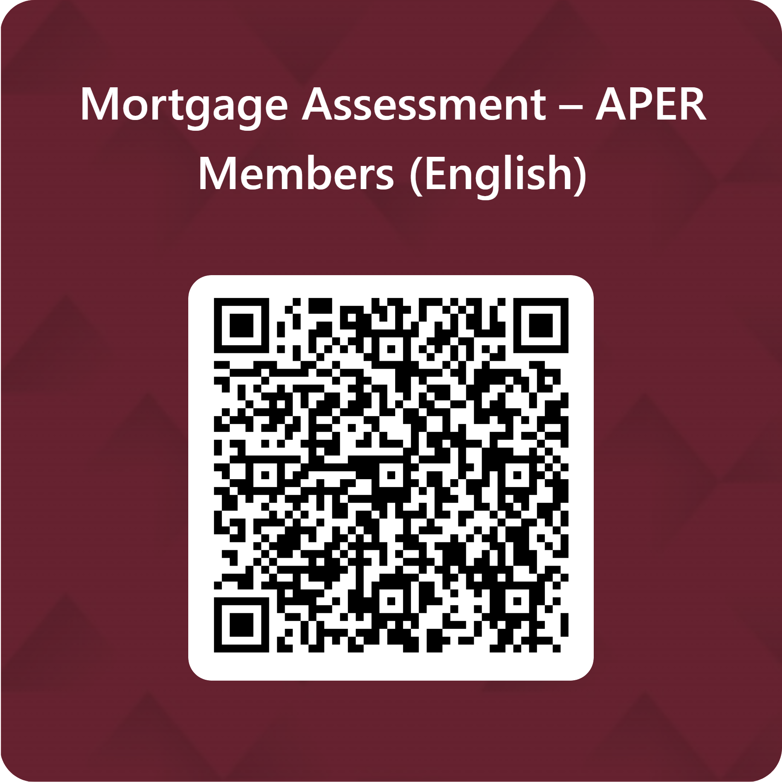
Financial Assessment:
Mortgage Assessment:

Slide 13
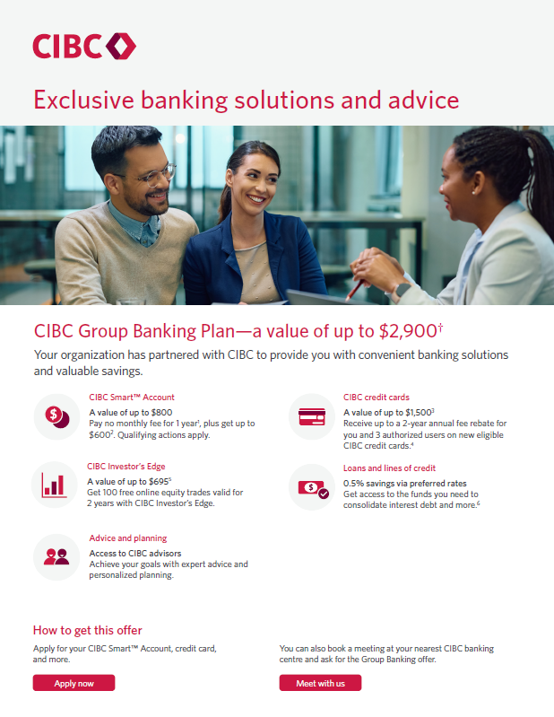
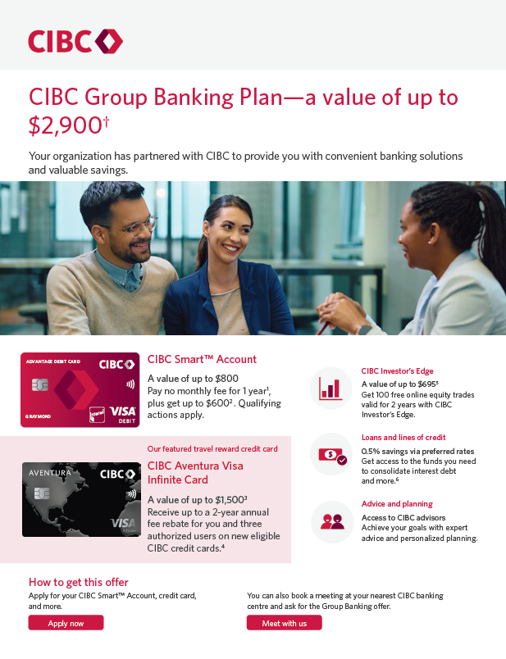
Examples of our Promotional Materials
  We will create customized marketing materials that Enrolled Organization can use to raise awareness to employees and members
1-page flyer for general use including websites and attached within email blasts
7
Notes:
Finally, to make this easy for your team, we provide all the marketing materials – email templates, custom made flyers – tailored with your branding.
We’d love to explore next step with you and bring this value to your employees.

Slide 14

Group Banking Offer Fulfillment
Different Group Banking offers can be fulfilled online and in banking centres – clients can choose the route that works best for them
Offer Element | Online | Banking Centre
New SmartTM Account
Add GB offer to existing Smart Account
New Credit Card
New Investors Edge Account
Loans (unsecured or HPP) and Lines of Credit
Mortgages
Advice (e.g., CGP or SmartPlan)
Fulfillment Steps | Clients can visit our online specific Group Banking landing page (to be shared once enrolled) | Clients can book a meeting at their nearest CIBC Banking Centre, ask for the Group Banking offer for their organization, bringing proof of employment or membership
4
Notes:
One of the things our partner really appreciate is how easy this is to roll out.
Employees can access the offer online, or if they prefer, go to a banking center for more personalized support.
If they are adding the GB offer to existing smart account – this will have be done in banking center
For investment, establishing new investor edge account would have to be done online
For lending, it has to be done via banking centre

Slide 15
Thank you
To Learn more :
Name : Riad Bourayou
Title : Area Sales Manager, Mobile Mortgage Advisors
Phone Number : (514)-475-2530
Courriel : riad.bourayou@cibc.com

