Slide 1

THE MANAGEMENT’S POSITIONS EVALUATION SYSTEM
Michelle Bourget et Anne-Marie Chiquette

Slide 2

OBJECTIVE
Teach APER members on the evaluation method leading to the classification of their position.

Slide 3
PROPOSED PLAN
STEP 1
Job Evaluation
The components of job evaluation
Important features of job evaluation
Job evaluation system:
Brief history
Structure of a job evaluation system
Job evaluation system in the health network

Slide 4
PROPOSED PLAN – STEP 2
The network’s managers evaluation system:
The factors
Sub-factors
The levels
Calculating the points
Understanding the responsabilities of the position
Consistency between positions
A revision of the ranking?

Slide 5

THE FUNCTION OF JOB EVALUATION
Job evaluation is used to determine the relative value of a function in the organization, thus creating a hierarchy between positions.

Slide 6
THE ESSENTIAL AND PRINCIPAL COMPONENTS OF JOB EVALUATION
1. The job evaluation system
2. Understanding the responsabilities of the position:
- Through the job description
- Through exchanges with the manager
3. Consistency between positions
- Through comparisons with similar positions in the institution or similar institutions or the network.

Slide 7

THE IMPORTANT FEATURES OF JOB EVALUATION CAN BE SUMMARIZED AS FOLLOWS:
It evaluates the position and not the « owner » of the position or the manner in which the « owner » performs his or her duties.
The basic information on which the evaluations are carried out is obtained from the analysis of the functions.

Slide 8
THE IMPORTANT FEATURES OF JOB EVALUATION CAN BE SUMMARIZED AS FOLLOWS:
A certain degree of subjectivity is always present in job evaluation.
Job evaluation does not set salary scales but simply provides a basis for the integration of a position into a salary structure.

Slide 9
JOB EVALUATION SYSTEMS
1- Brief history of job evaluation
2- Structure of a job evaluation system
3- Job evaluation systems in the health network

Slide 10
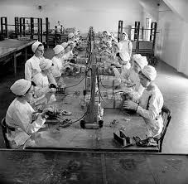
1-BRIEF HISTORY
Job evaluation is not new. In 1853, the principle of equal work/equal pay was adopted by the United States Congress. This principle introduces, among other things:
Comparison between positions;
Position classifications;
A task analysis
Over the decades, many approaches and studies have led to the current job evaluation systems and the important principle of EQUAL work at the EQUAL workplace.

Slide 11
2- STRUCTURE OF A JOB EVALUATION SYSTEM
Job evaluation systems are made up of factors that are divided into sub-factors that are themselves divided into levels.
It is required that four factors be always present in the structure of an evaluation system.
1. Efforts (intellectual and physical);
2. Responsibilities;

Slide 12
2- STRUCTURE OF A JOB EVALUATION SYSTEM
3.Qualifications;
4. Working conditions (physical and psychological).
These factors may be named differently, depending on the assessment system, but they must be interpreted in the same way.

Slide 13
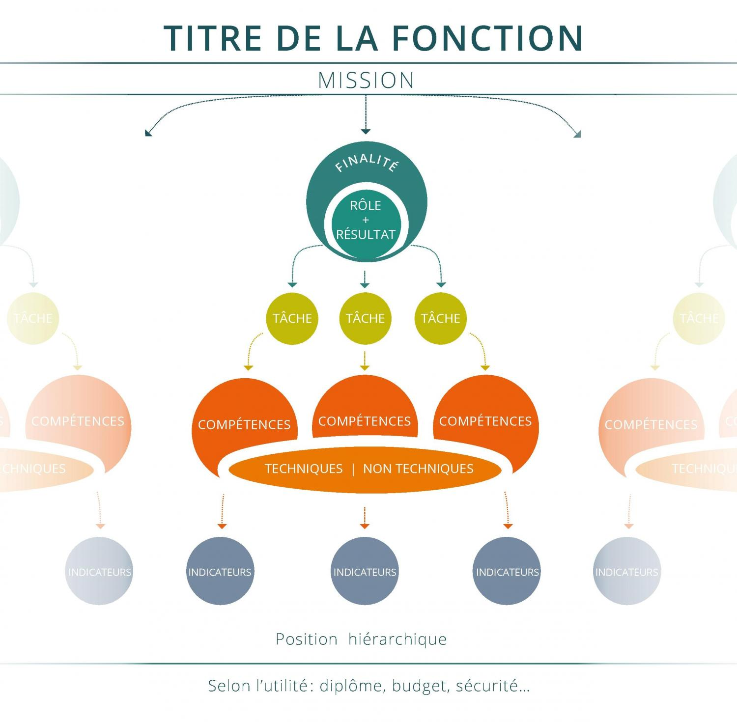
2- STRUCTURE OF A JOB EVALUATION SYSTEM
The factors are further divided into sub-factors. There is no limit to the number of sub-factors. However, these sub-factors must be relevant and necessary to the evaluation.

Slide 14
2- STRUCTURE OF A JOB EVALUATION SYSTEM
For example, in the qualifications factor, a sub-factor that includes the requirement of a foreign language, such as Spanish for example, could not be included for an organization in which that language is not required in any position.

Slide 15
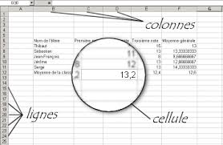
2- STRUCTURE OF A JOB EVALUATION SYSTEM
Finally, each sub-factor has levels of difficulty or requirements specific to each of them.
For example, in the academic qualifications sub-factor, we will find a progression in levels that goes from high school diploma to doctorate. The principle of progression is found in all levels of the sub-factors.
Points are awarded according to the level chosen. The total points obtained at the end of the exercise determine the ranking of the position.

Slide 16
3-JOB EVALUATION SYSTEMS IN THE HEALTH NETWORK
The health network consists mainly of two job evaluation systems.
The first is for unionized and SNS staff and the second is for middle managers and senior managers.
The first system has 17 sub-factors, while the system used for managers has 10 sub-factors.

Slide 17
LE SYSTÈME D’ÉVALUATION DES POSTES DE CADRES
The management evaluation system consists of the following four factors:
1. The Nature of Responsibilities
2. Qualifications
3. Accountability
4. Working conditions
We'll look at each of these factors with their respective sub-factors.

Slide 18
1. The nature of the responsibilities
Three sub-factors are present in this factor:
A) The complexity of decision-making;
B) Freedom of action;
C) The Impact of Decisions
Let's briefly examine the content of each sub-factor

Slide 19
A) The complexity of decision-making
This sub-factor measures the degree of difficulty of the decisions to be made, it considers:
The subject matter of the decisions;
The framework in which they should be taken;
The characteristics of the situations;
The persons concerned.
This sub-factor is broken down into 7 levels of measurement. (7 main levels, divided into ABC for overlaps for a possible 21 levels)
20% of the points in the evaluation system are devoted to this
Middle managers are most often found at level 2 and 3 and sometimes at level 4.

Slide 20

B) Freedom of action
This sub-factor measures the level and extent of decision-making powers, i.e., autonomy in decision-making and the degree of initiative. It includes elements such as, among others:
The initiative allowed;
The degree of judgment;
The level of analysis required;
The expected results and the means left to the manager's discretion to achieve them.
This sub-factor is broken down into 6 levels of measurement.
11.64% of the points in the system are devoted to it

Slide 21
C) The Impact of Decisions
This sub-factor measures the impact of decisions both inside and outside the organization. It considers:
The subject matter of the decisions
The repercussions produced
The organizational unit affected.
This sub-factor is broken down into 5 levels of measurement.
6.65% of the points in the system are devoted to it

Slide 22


2. Qualifications
Two sub-factors are present in this factor:
A) Academic knowledge;
(B) Practical knowledge;
Let's briefly examine the content of each sub-factor

Slide 23
A) Academic knowledge
This sub-factor measures the minimum academic knowledge required to perform the duties of the position.
This sub-factor is broken down into 10 levels of measurement ranging from high school to doctoral studies.
18.51% of the points in the system are devoted to it

Slide 24
B) Practical knowledge
This sub-factor measures the accumulation of practical management work experience that has made it possible to master the requirements of the position. It measures the minimum duration.
01
It is broken down into 6 levels of measurement that range from 3 years to 18 years old.
02
12.19% of the points in the system are devoted to it
03

Slide 25
3. Accountability
Three sub-factors are present in this factor:
A) The nature of the management exercised;
B) The number of employees led;
C) Communications.
Let's briefly examine the content of each sub-factor

Slide 26
A) The nature of the leadership
This sub-factor measures the degree of supervision of a position.
It refers to the administrative functions of:
planning;
organisation;
direction;
coordination;
control.
There are two types of authority: hierarchical authority or functional authority.
This sub-factor is broken down into 5 levels of measurement
12.19% of the points in the system are devoted to it

Slide 27

B) Number of employees led
This sub-factor quantitatively measures the responsibility for human resources management. In functional authority, this sub-factor is not retained.
The ETC number is considered in direct and indirect supervision
This sub-factor is broken down into 11 levels of measurement that range from 1 to 4 people up to the supervision of 2000 or more people.
6.65% of the points in the system are devoted to it

Slide 28
C)Communications
This sub-factor measures the difficulty of routine communication in the performance of the duties of the position. For example, we will consider confronting, conflictual, problematic interrelationships, etc.
It does not analyze the nature of communications, which is present in the Complexity of Decision Making sub-factor.
This sub-factor is broken down into 6 levels of measurement
6.65% of the points in the system are devoted to it

Slide 29
4. Working conditions
Two sub-factors are present in this factor:
A) Physical conditions;
B) Psychological conditions.
Let's briefly examine the content of each sub-factor

Slide 30
A) Physical conditions
This sub-factor measures the inconveniences related to the work environment that generate discomfort
These inconveniences must be inherent to the position and not punctual.
That sub-factor is broken down into 2 measurement levels
1.66% of the points in the system are devoted to it

Slide 31
B) Psychological conditions
This sub-factor measures the psychological conditions that are inherent in the exercise of the responsibilities of the position.
This sub-factor is directly related to the first sub-factor of the system, the Complexity of Decision-Making. The greater and more complex the difficulty of decision-making, the more psychological conditions are considered
This sub-factor is broken down into 18 levels of measurement
3.88% of the points in the system are devoted to it

Slide 32
Calculating points
Once the levels for each sub-factor have been determined, points are awarded based on the level achieved.
The progression of points in the levels is arithmetic and the differences between the different levels are equal.
The number of points assigned to each sub-factor is different and takes into account the importance given to the sub-factor.

Slide 33

Calculating points
For each sub-factor, the percentage, points and number of levels assigned to it are as follows:
THE NATURE OF THE LIABILITY: 38.29% OF THE TOTAL POINTS
Complexity of decision-making: 20% of the points or 20 to 180 points spread over 21 levels
Freedom of action: 11.64% of the points or 20 to 105 points spread over 6 levels
Impact of decisions: 6.65% of the points, i.e. 12 to 60 points spread over 5 levels

Slide 34
Calculating points
For each sub-factor, the percentage, points and number of levels assigned to it are as follows:
QUALIFICATIONS: 30.7% OF TOTAL POINTS
Academic knowledge: 18.51% of the points or 13 to 167 points distributed in 10 levels
Practical knowledge: 12.19% of the points or 30 to 110 points spread over 6 levels

Slide 35

Calculating points
For each sub-factor, the percentage, points and number of levels assigned to it are as follows:
ACCOUNTABILITY: 25.49% OF TOTAL POINTS
Nature of the management: 12.19% of the points or 30 to 110 points spread over 5 levels
Number of employees led: 6.65% of the points or 20 to 60 points spread over 11 levels
Communications: 6.65% of the points, i.e. 10 to 60 points spread over 6 levels

Slide 36
Calculating points
For each sub-factor, the percentage, points and number of levels assigned to it are as follows:
WORKING CONDITIONS: 5.54% OF TOTAL POINTS
Physical working conditions: 1.66% of the points, i.e. 5 to 15 points divided into 2 levels
Psychological working conditions: 3.88% of the points or 1 to 35 points spread over 18 levels

Slide 37
Calculating points
Finally, the points awarded to each of the sub-factors are added together and the total of these points determines the job class that is assigned to the position.
A weighting table shows the differences between which the job classes fall.
For example, Class 39 includes positions with between 466 and 490 points, and Class 40 includes positions with between 491 and 515 points, and so on, from Class 30 to Class 48.

Slide 38
Knowledge of the duties of the position
Two essential elements to knowledge of the functions of the position
- The job description
Normally, all positions should have a job description. This description sets out a summary of the responsibilities followed by the details of those responsibilities, including the qualifications, skills and other information necessary to make an assessment.
On the other hand, we sometimes find ourselves with just the job posting. This posting can allow an evaluation by taking into account the notion of coherence that must exist between the positions.
- Exchanges with the incumbent
Exchanges with the holder are always required to obtain additional information or clarifications necessary for the evaluation process.

Slide 39

Consistency between positions
Once the evaluation is completed, it is common practice to make comparisons between positions of the same nature in similar institutions to ensure consistency between them.
These comparisons take into account elements such as the mission or size of the institution, the academic vocation, the budget allocated, etc.

Slide 40

A revision of the ranking?
A review of the classification of a position is always possible subject to the following events:
A change made by the Minister to the system or procedures for classifying and evaluating positions;
The appointment of the executive, if the change in responsibilities is the result of an administrative reorganization;
A change introduced by the employer to the responsibilities of the position;
The evolution of the responsibilities of the position.
A review procedure is provided for in the Regulations that govern the working conditions of executives.
Your REA advisors are there to help you if necessary.
However, it should be noted that the final decision cannot be appealed.

Slide 41
THANK YOU FOR YOUR ATTENTION
QUESTIONS?

